Slide 1
Hand Gesture Recognition System Enabling Real-Time Interaction Through Hand Movements

Slide 2
TABLE OF CONTENTS
01.
02.
03.
04.
Introduction & Objectives
Data & Model Overview
Project idea, goals, and its importance for real-time interaction and accessibility .
Dataset collection, preprocessing, model architecture, and performance .
Challenges, Future Improvements & Conclusion
Real-Time Demo & Applications
Live demonstration and practical uses like device control and VR .
Key challenges, suggested improvements, and project impact .

Slide 3
01.
Introduction & Objectives

Slide 4
INTRODUCTION
Real-time detection: Captures hand gestures as they happen .
Gesture translation: Converts hand movements into computer/device commands.
Applications:
- Control programs or devices.
- Display content.
- Assist people with speech difficulties.

Slide 5
Objectives :
Accurately recognize hand gestures in real-time.
Enable users to interact with devices without using a keyboard or mouse.
Practical applications in :
Human-Computer Interaction (HCI) .
Virtual Reality (VR).
Accessibility for people with speech difficulties .
Facilitate communication for people with speech impairments using gestures.

Slide 6
02.
Data & Model Overview

Slide 7
SEQUENCE
Data Collection
Data Preprocessing
Model Selection
Model Architecture
Model Training
Model Evaluation

Slide 8
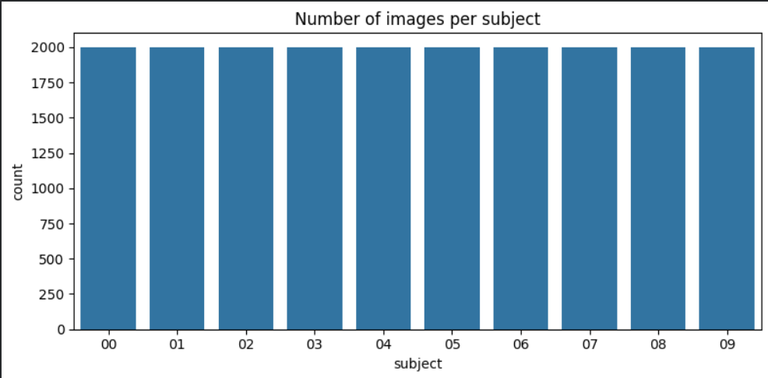
Data Collection :
- Dataset: Hand Gesture Recognition Database
Data Preprocessing
- Data Augmentation
- Normalize pixel values (scale 0–1)
- Simple Data Visualization

Slide 9
Model Selection
- A Convolutional Neural Network (CNN) was selected for handling the gesture image classification task.
Model Training
Optimizer: Adam with learning rate 0.0008
Loss function: Categorical Crossentropy
Metrics: Accuracy
Epochs: 15
Batch size: 64
Data Augmentation: rotation, zoom, width/height shift, shear, horizontal flip
Callbacks: EarlyStopping (patience=7, restore best weights), ReduceLROnPlateau (patience=3, factor=0.3, min_lr=1e-6)
Validation: monitored on validation set during training
Output: trained CNN model ready for evaluation

Slide 10
Model Architecture
Layer Type | Filters / Units | Kernel / Size | Activation | Dropout
Conv2D | 32 | 3x3 | ReLU | 0.25
Conv2D | 32 | 3x3 | ReLU | -
MaxPooling2D | - | 2x2 | - | -
Conv2D | 64 | 3x3 | ReLU | 0.30
Conv2D | 64 | 3x3 | ReLU | -
MaxPooling2D | - | 2x2 | - | -
Conv2D | 128 | 3x3 | ReLU | 0.40
Conv2D | 128 | 3x3 | ReLU | -
MaxPooling2D | - | 2x2 | - | -
Dense | 256 | - | ReLU | 0.50
Dense (Output) | num_classes | - | Softmax | -

Slide 11
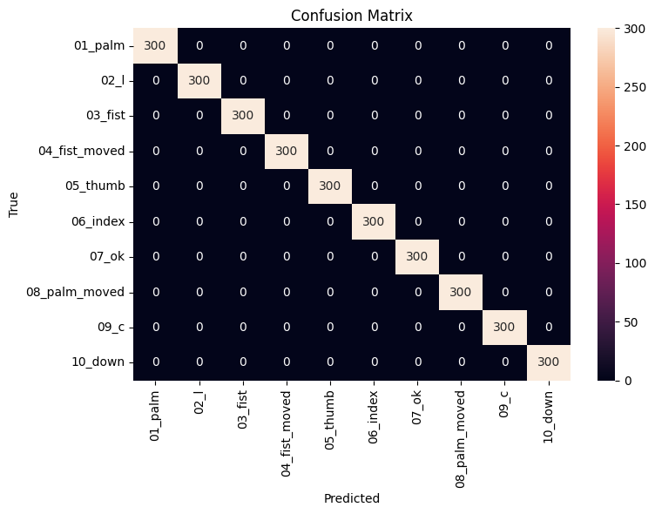
Confusion matrix to show correct and incorrect predictions

Slide 12
03.
Real-Time Demo & Applications

Slide 13
Real-Time Demo & Applications
-Capture live hand gestures using a camera
-Predict gestures in real-time with the trained model
Practical applications:
- Control a mouse or presentations .
- Interact with VR environments .
- Accessibility tools for people with speech difficulties .
Screenshot

Slide 14
Video

Slide 15
05.
Challenges, Future Improvements & Conclusion

Slide 16



Challenges
01.
02.
03.
Limited Dataset
Variations
Real-Time Performance
Not enough examples for all gestures
Different hand positions, lighting, and backgrounds
Maintaining fast and accurate recognition

Slide 17
Future Improvements
Accessibility Applications
Integration with VR/AR
Expand Dataset
Add more hand gestures and real-world variations for better accuracy.
Apply gesture recognition in virtual or augmented reality environments.
Help people with speech or mobility difficulties communicate more easily.
Improve Real-Time Performance
Use Advanced Models
Cross-Platform Compatibility
Optimize the model to reduce latency and run faster on live video.
Experiment with newer pre-trained models for improved feature extraction
Make the system work on multiple devices and operating systems for wider accessibility.

Slide 18

Conclusion
Recognizes hand gestures in real-time.
Enables device control and assists people with speech difficulties.
Utilizes deep learning and computer vision .
Can be improved for greater speed, accuracy, and wider applications.
N
E
D

Slide 19
K
N
T
H
A
Y
U
O

